Slide 1
Web Scraping Documentation 9th May 2024

Slide 2
Introduction
The slides contain:
Screenshots of websites’ current layout & what is being scraped
Brief walkthrough of how the code navigates the sites
Last updated: 9th May 2024

Slide 3
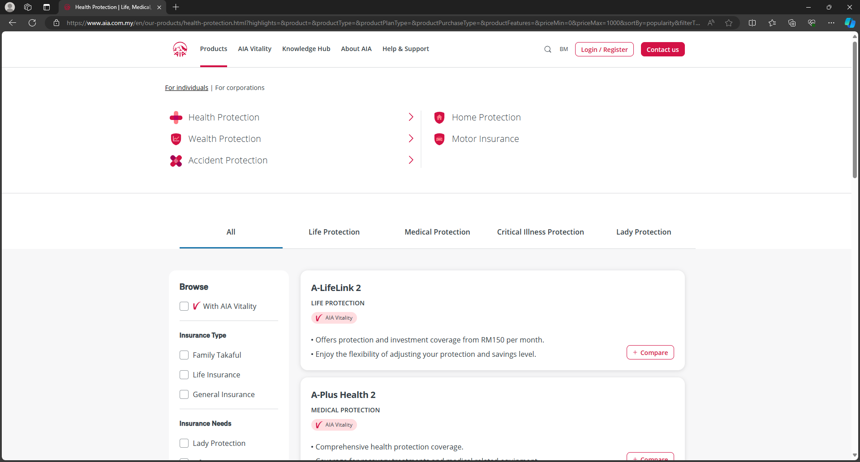
AIA
Start from these 5 sites
product name
product type
description

Slide 4
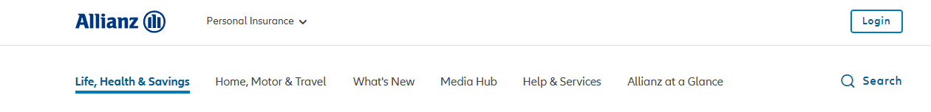
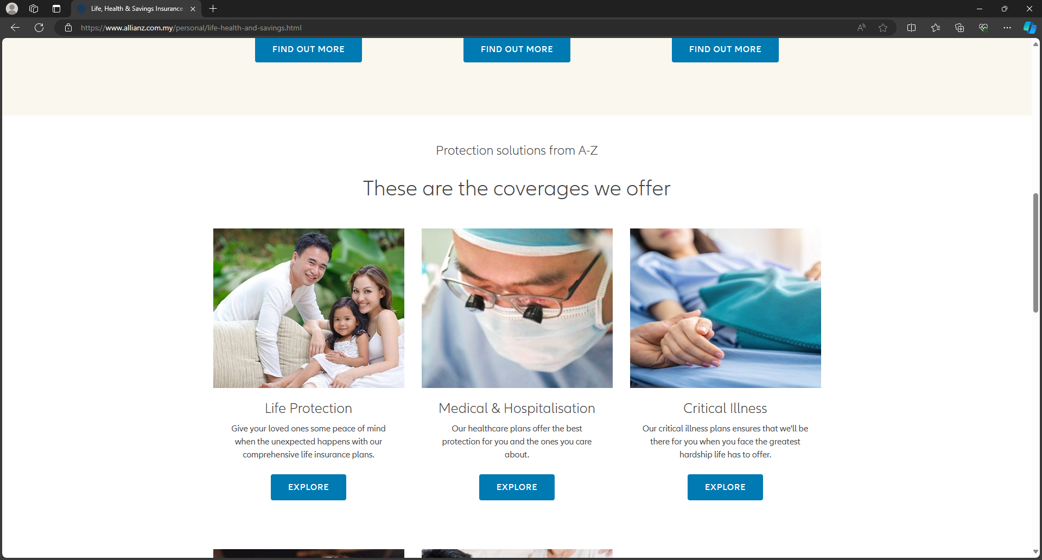
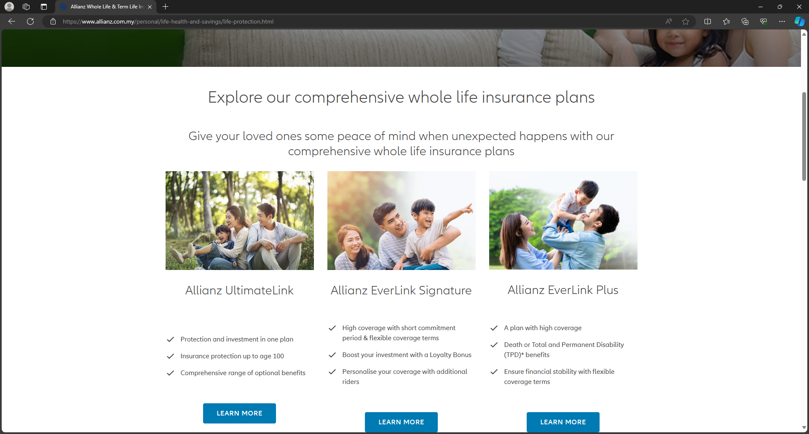
Allianz
1. Start from these 2 sites
2. scrape links and product types
3. Visit each link to scrape name and description
product type
product name
description

Slide 5
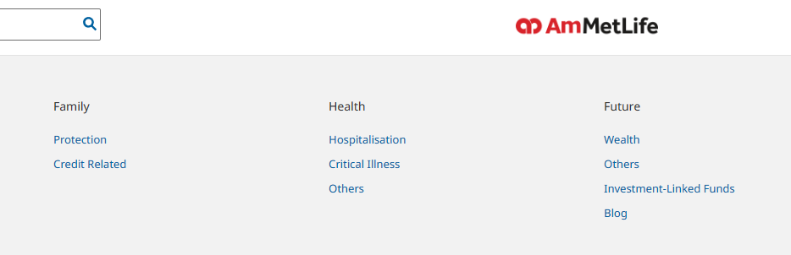
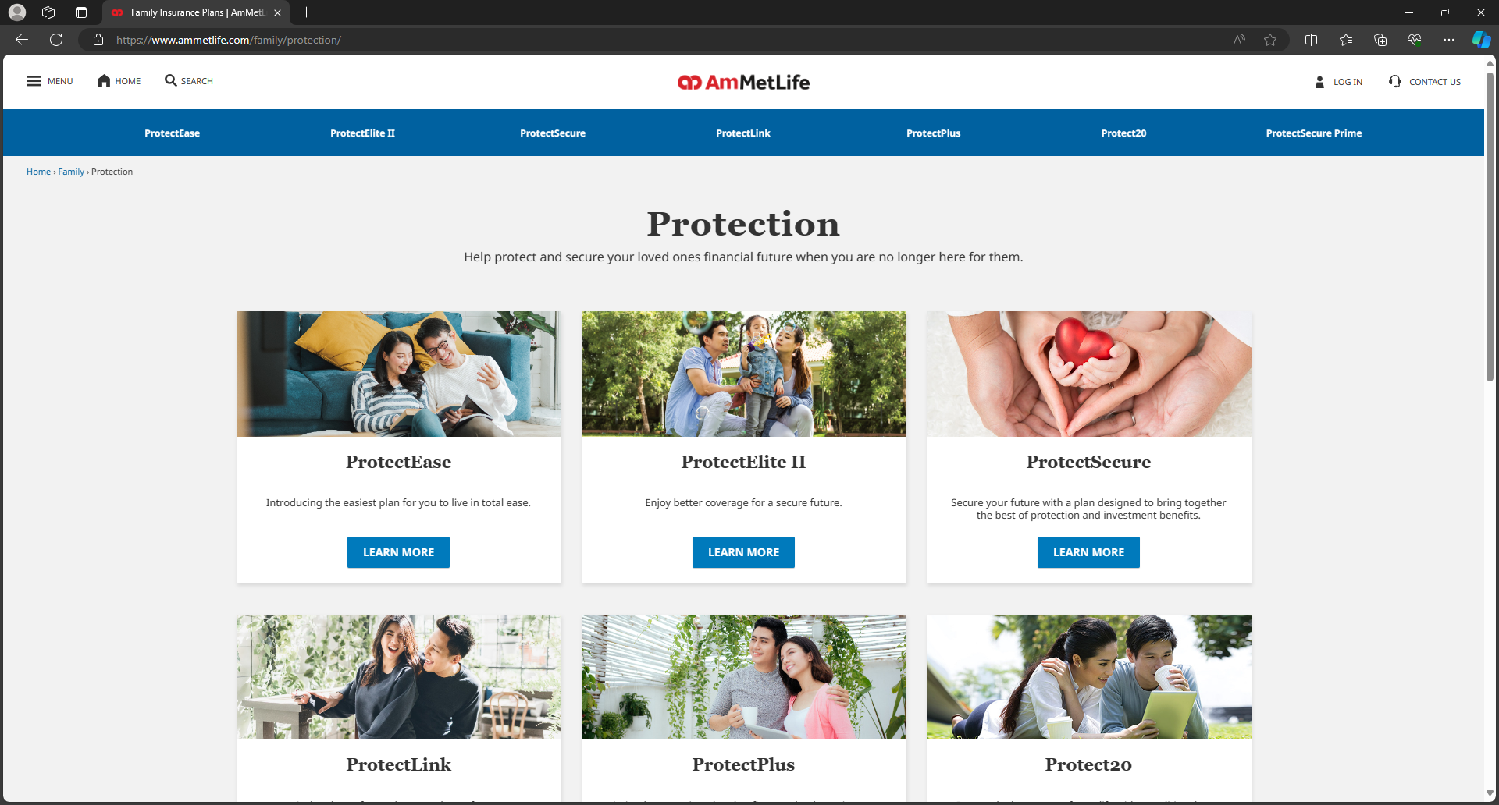
AmMetLife
1. Start from these 5 sites in the menu
product type
2. Scrape from each site
product name
description

Slide 6
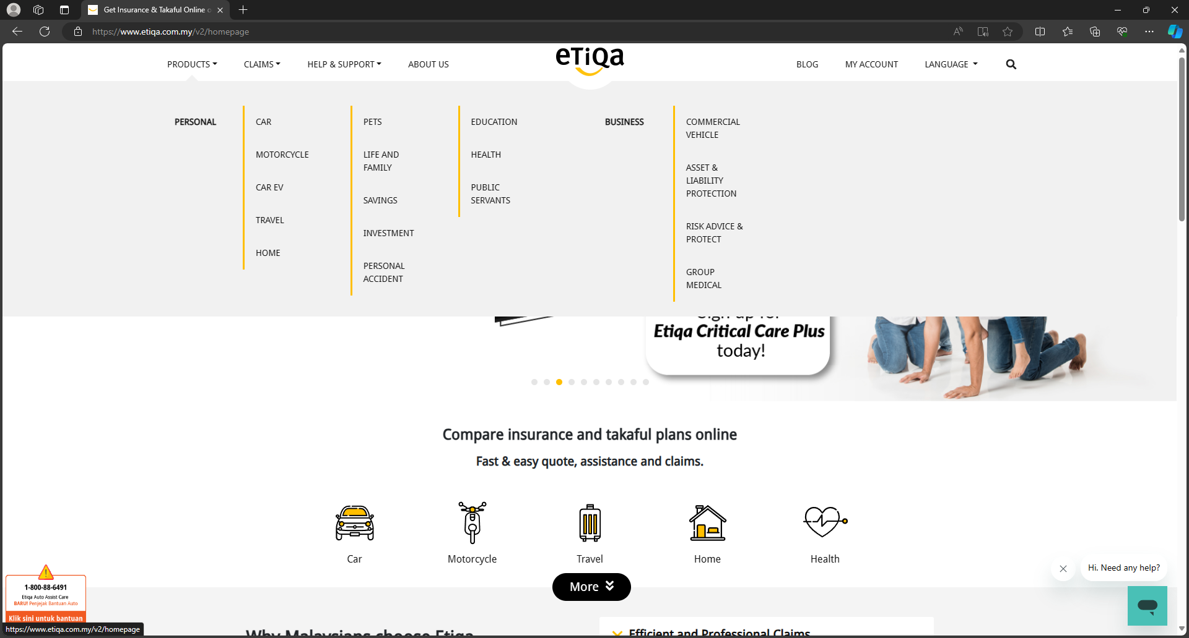
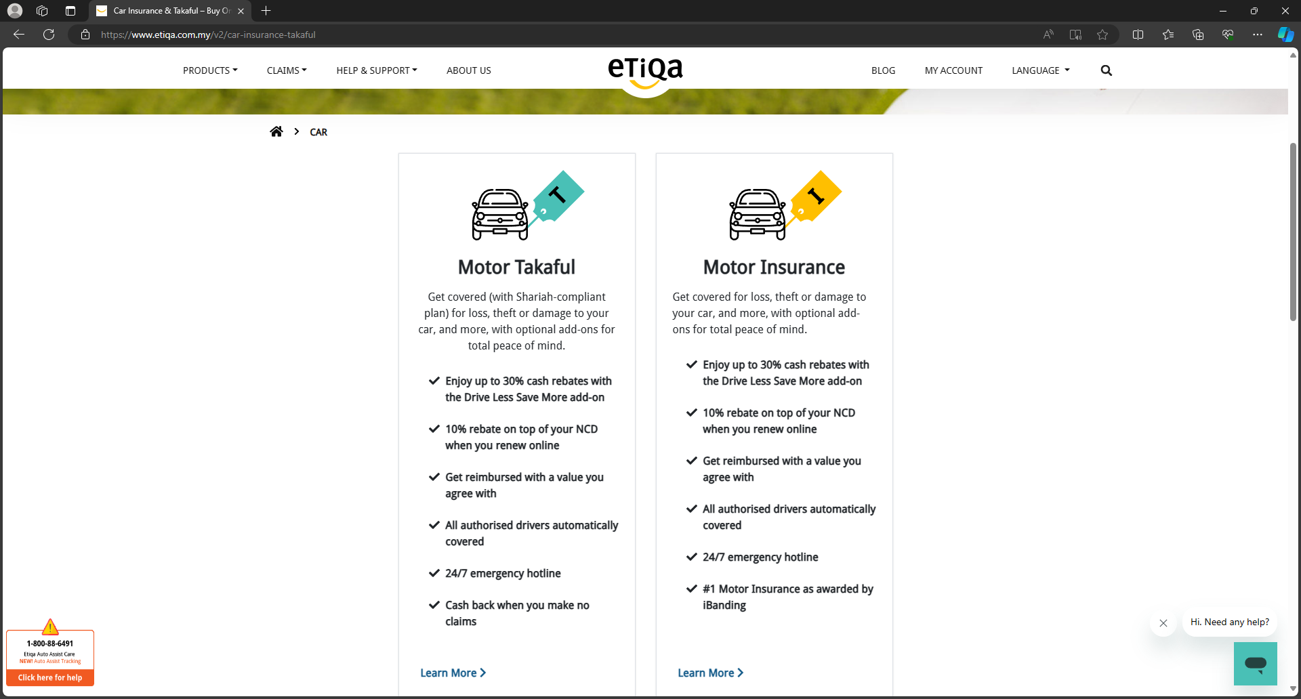
Etiqa
Start from homepage, scrape all these links
and product types
product type
2. Visit each link
product name
description

Slide 7
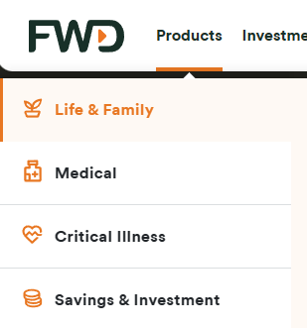
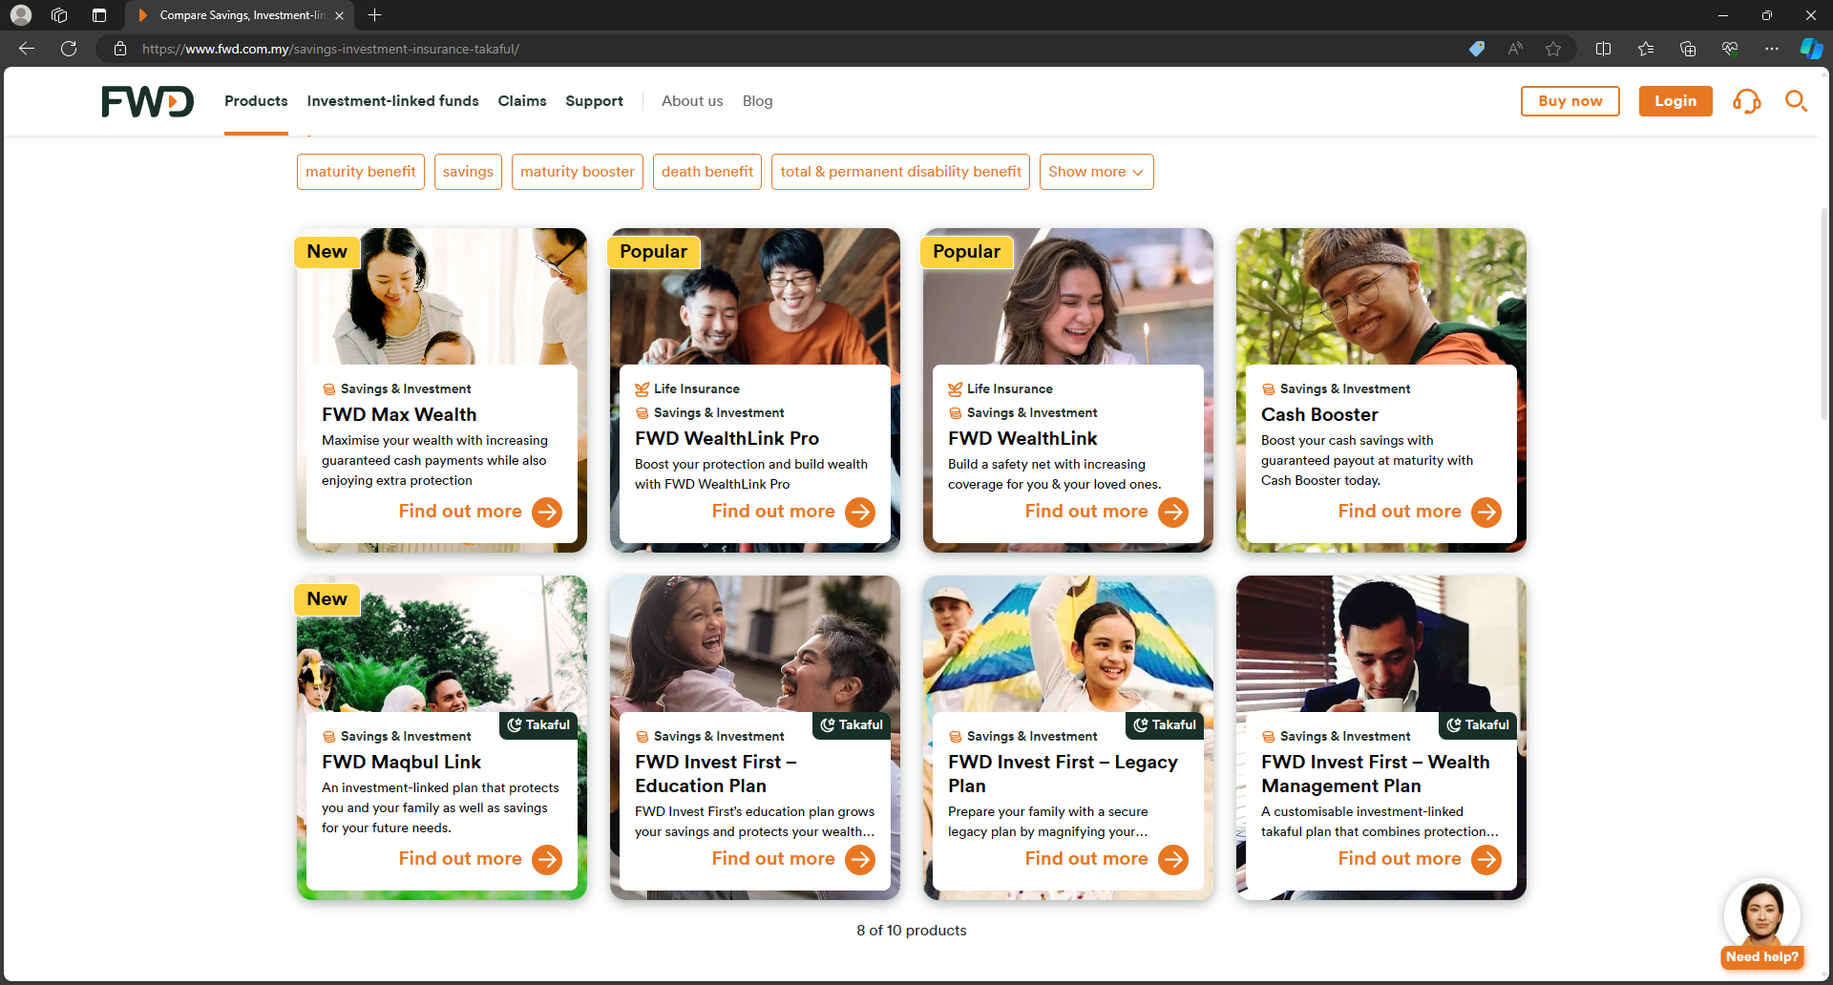
FWD
Start from these 4 sites found in products dropdown, then scrape names and descriptions
product type
product name
description

Slide 8
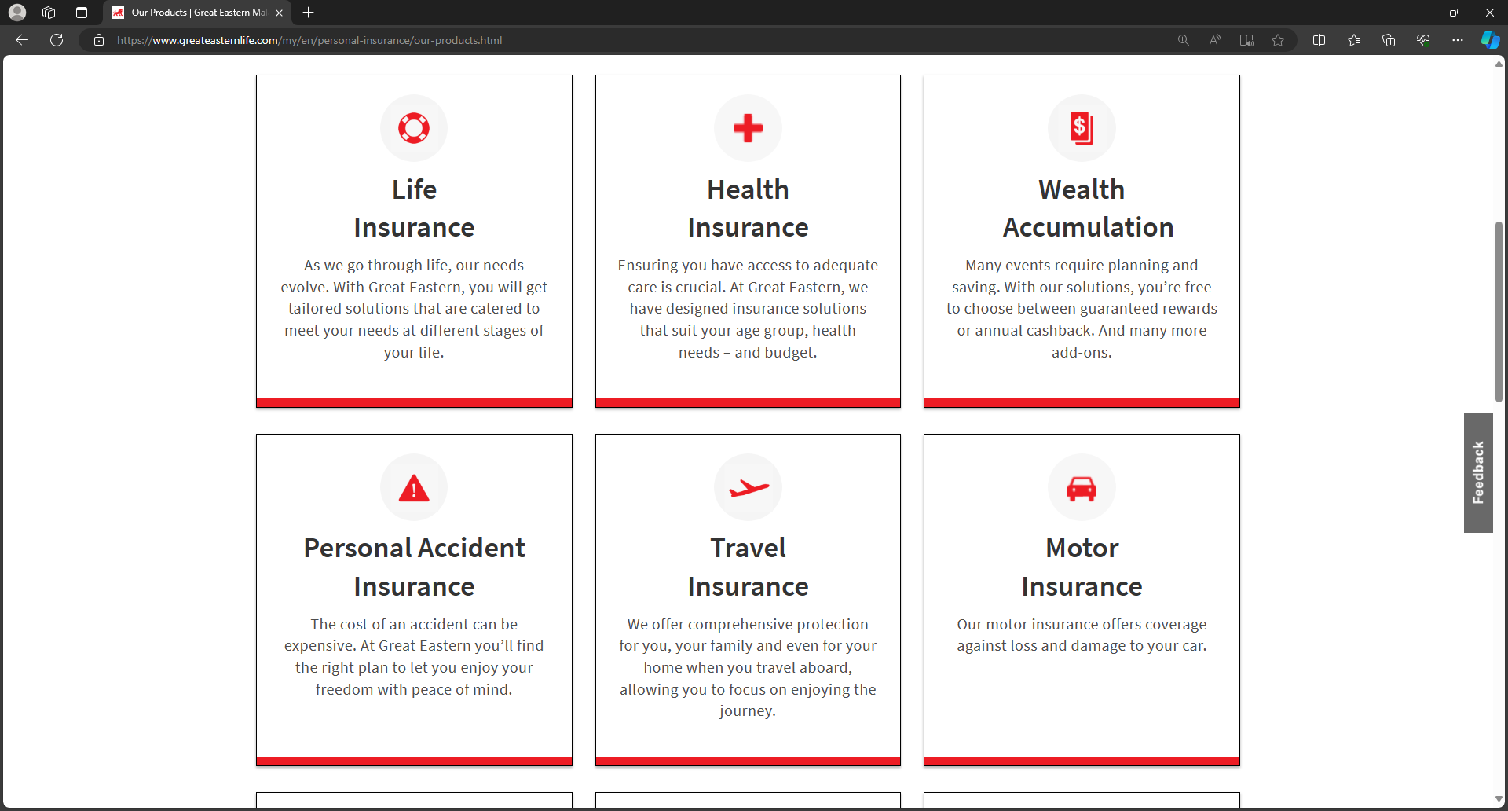
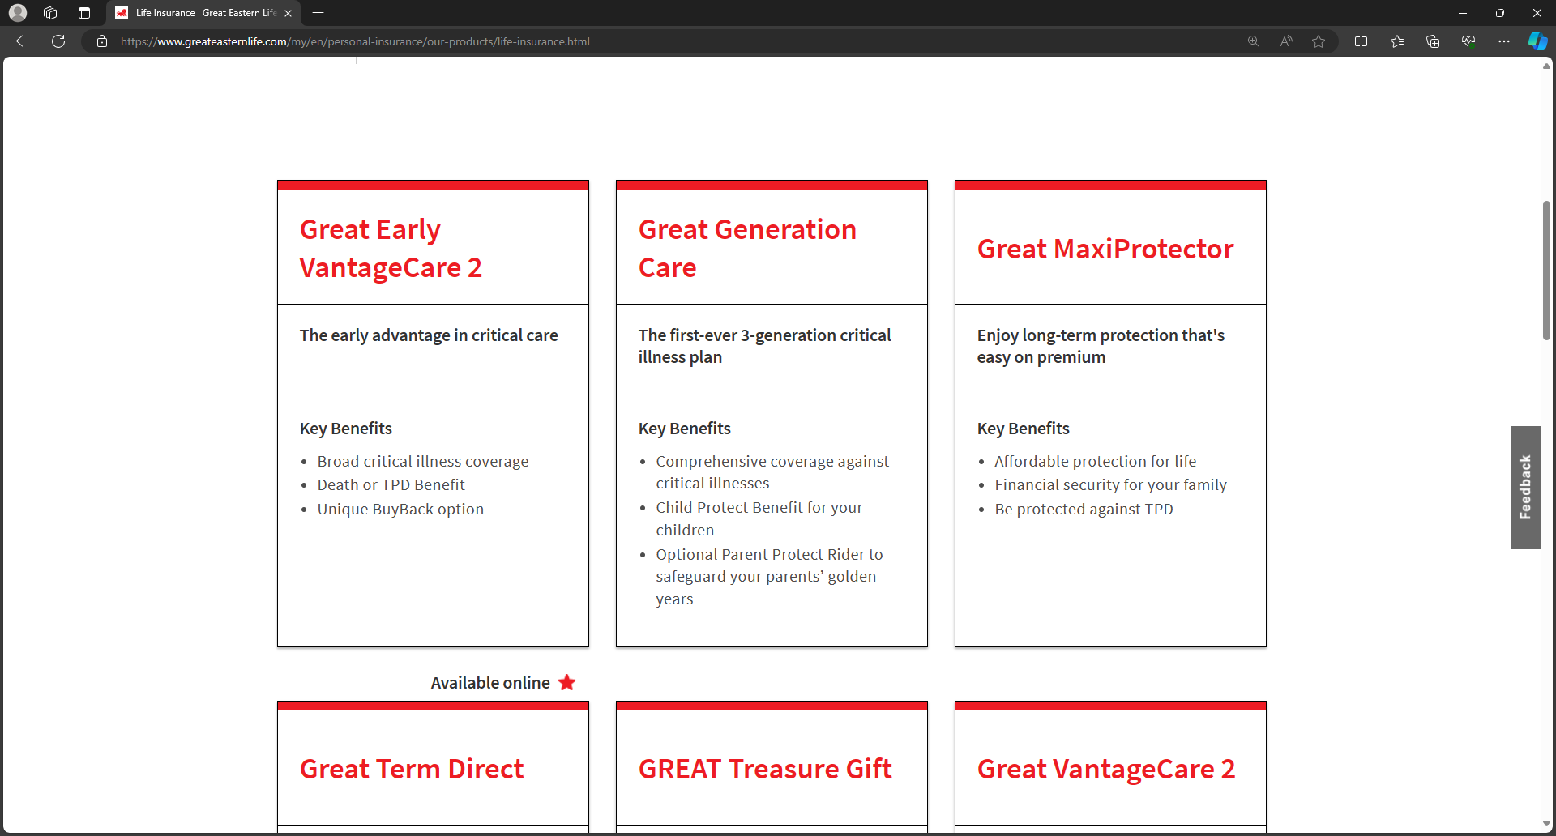
Great Eastern
Start from this “Our Products” site,
scrape links and product types
product type
2. Visit each link to scrape name and description
product name
description

Slide 9
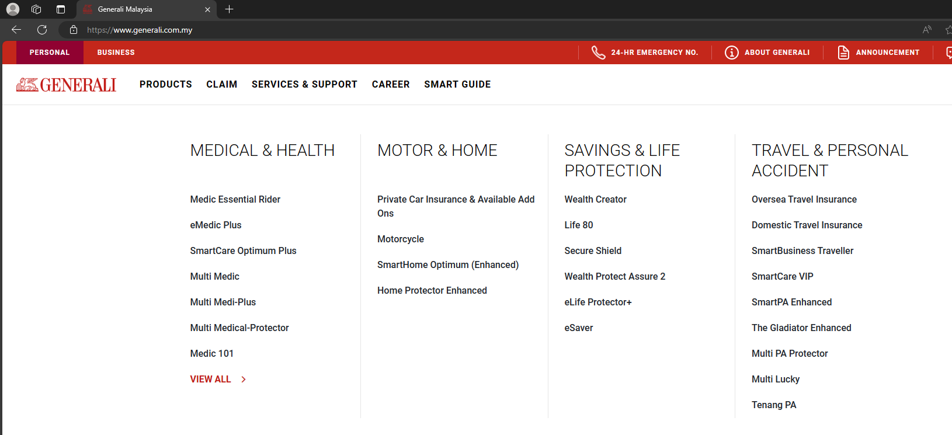
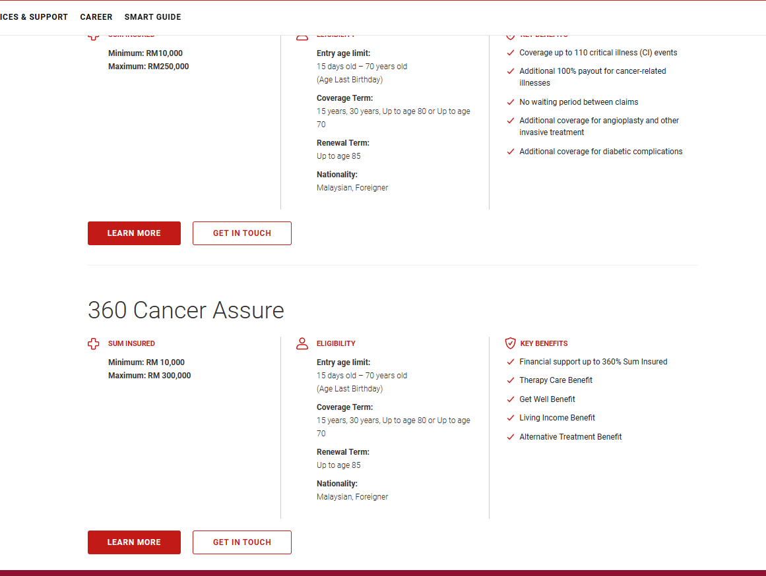
Generali
1. Start from homepage, scrape all these links
2. Visit the “View All” page and scrape any extra links

Slide 10
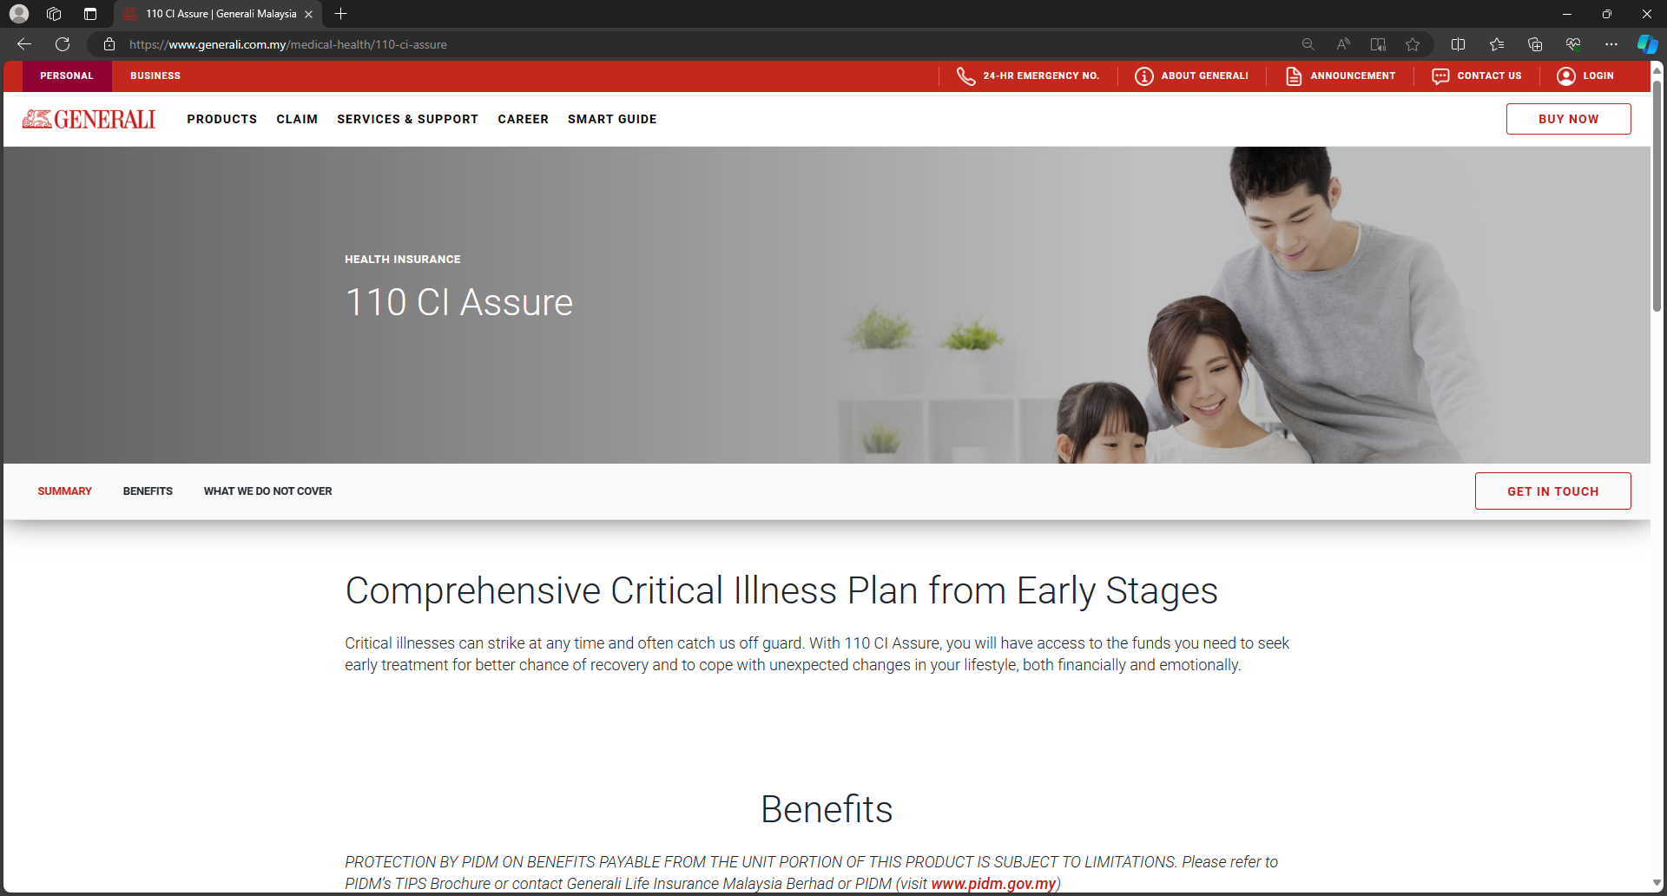
Generali
product type
product name
3. Visit all the scraped links. Scrape product info
description

Slide 11
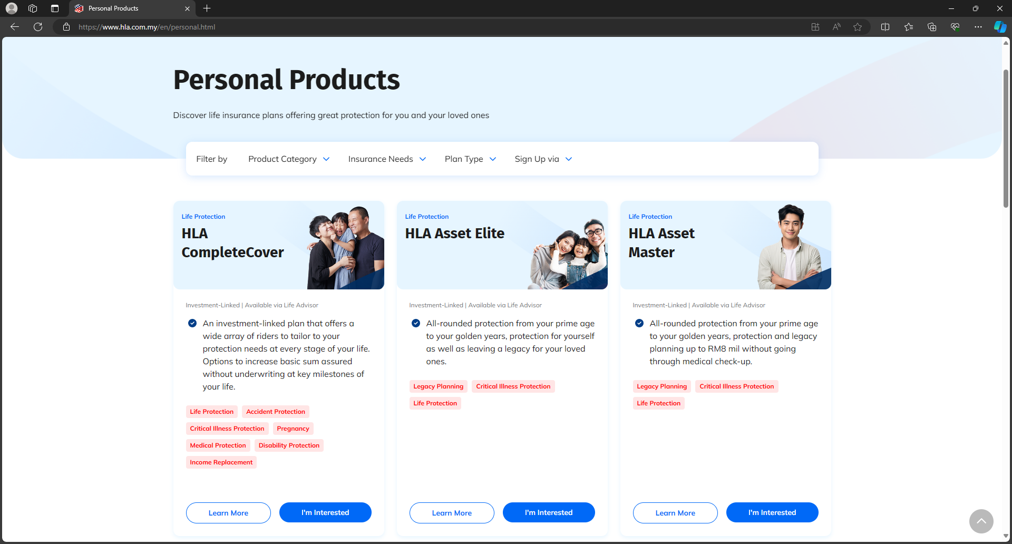
Hong Leong Assurance
Start at this site, which contains all personal products’ info
product type
product name
description

Slide 12
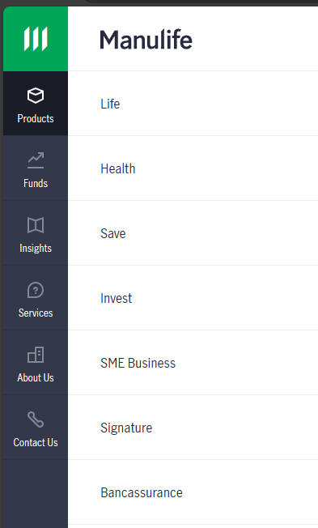
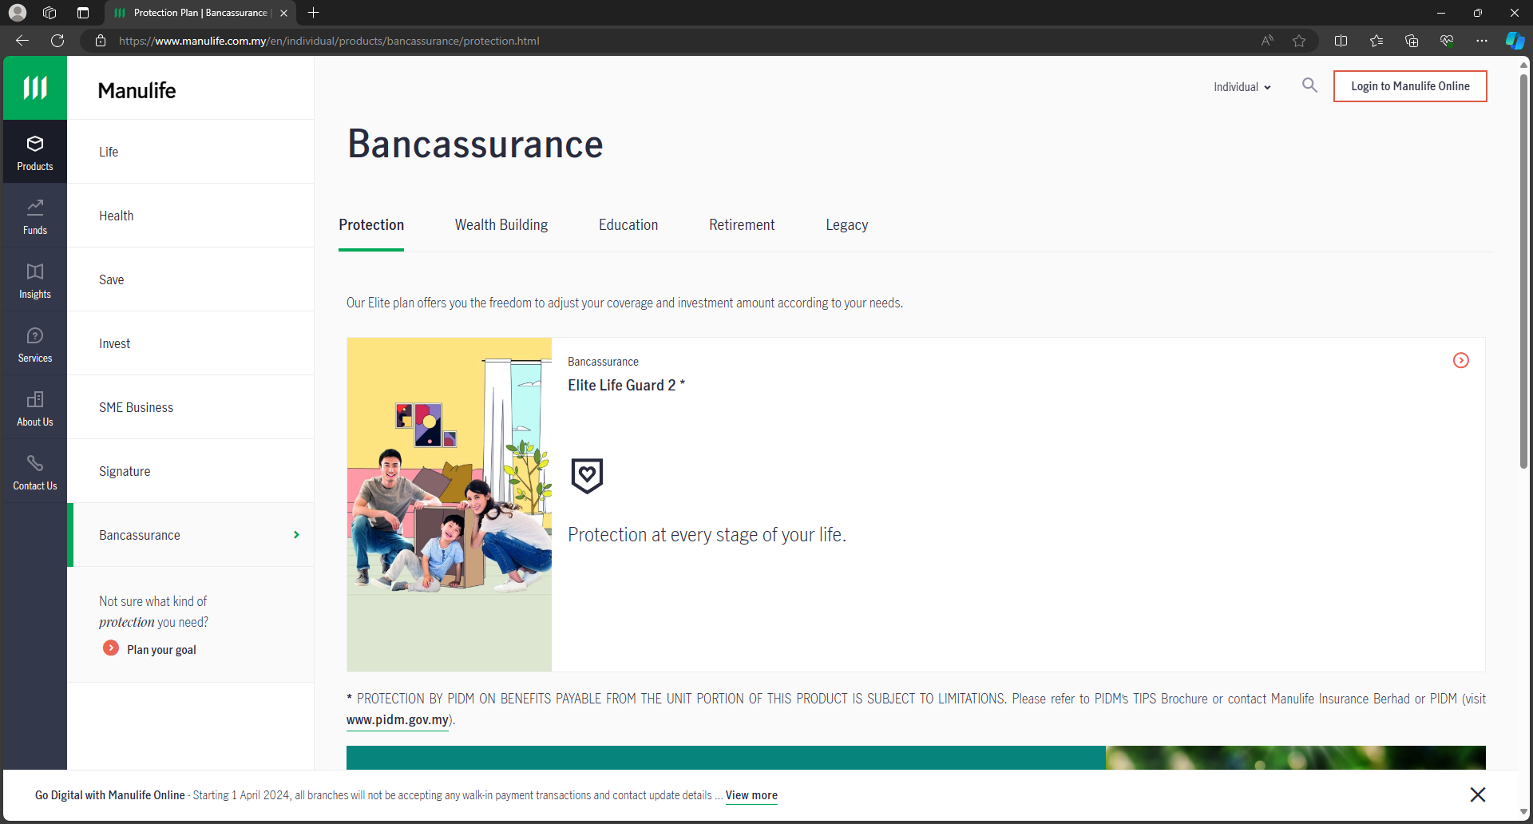
Manulife
1. scrape links from sidebar
2. Visit each scraped link, scrape links in blue and product types
3. Visit each site, scrape name and description
product type
product name
description

Slide 13
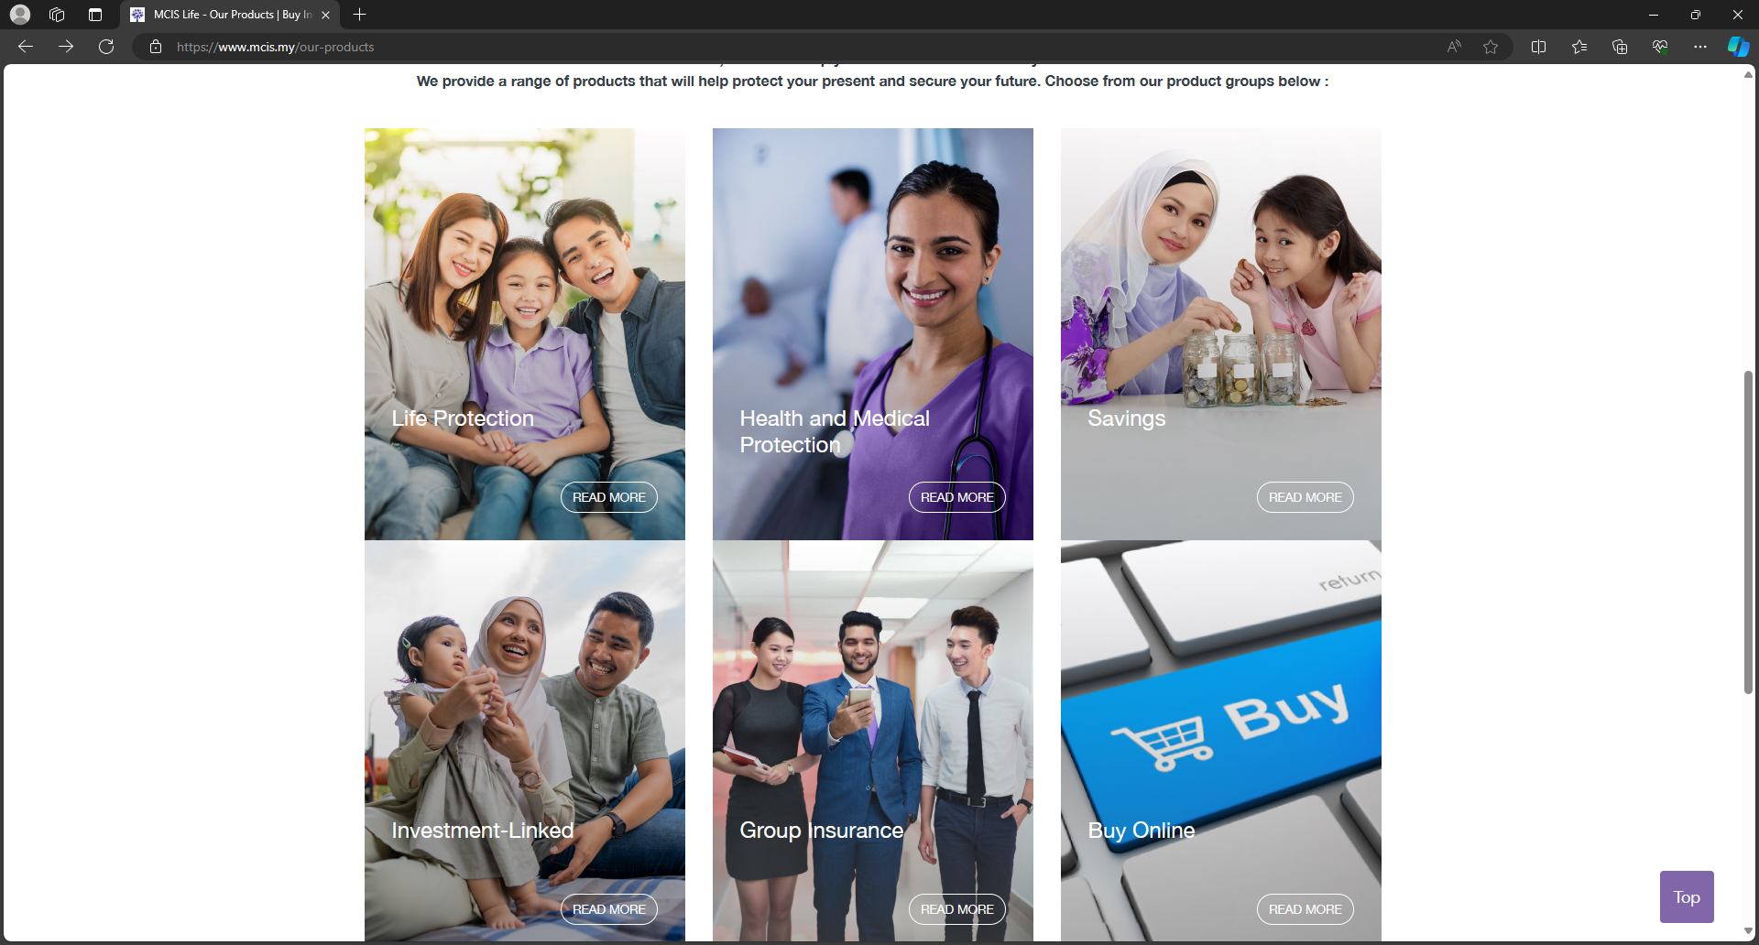
MCIS Life
1. Start at ‘our products’ site, scrape links and product types
product type

Slide 14
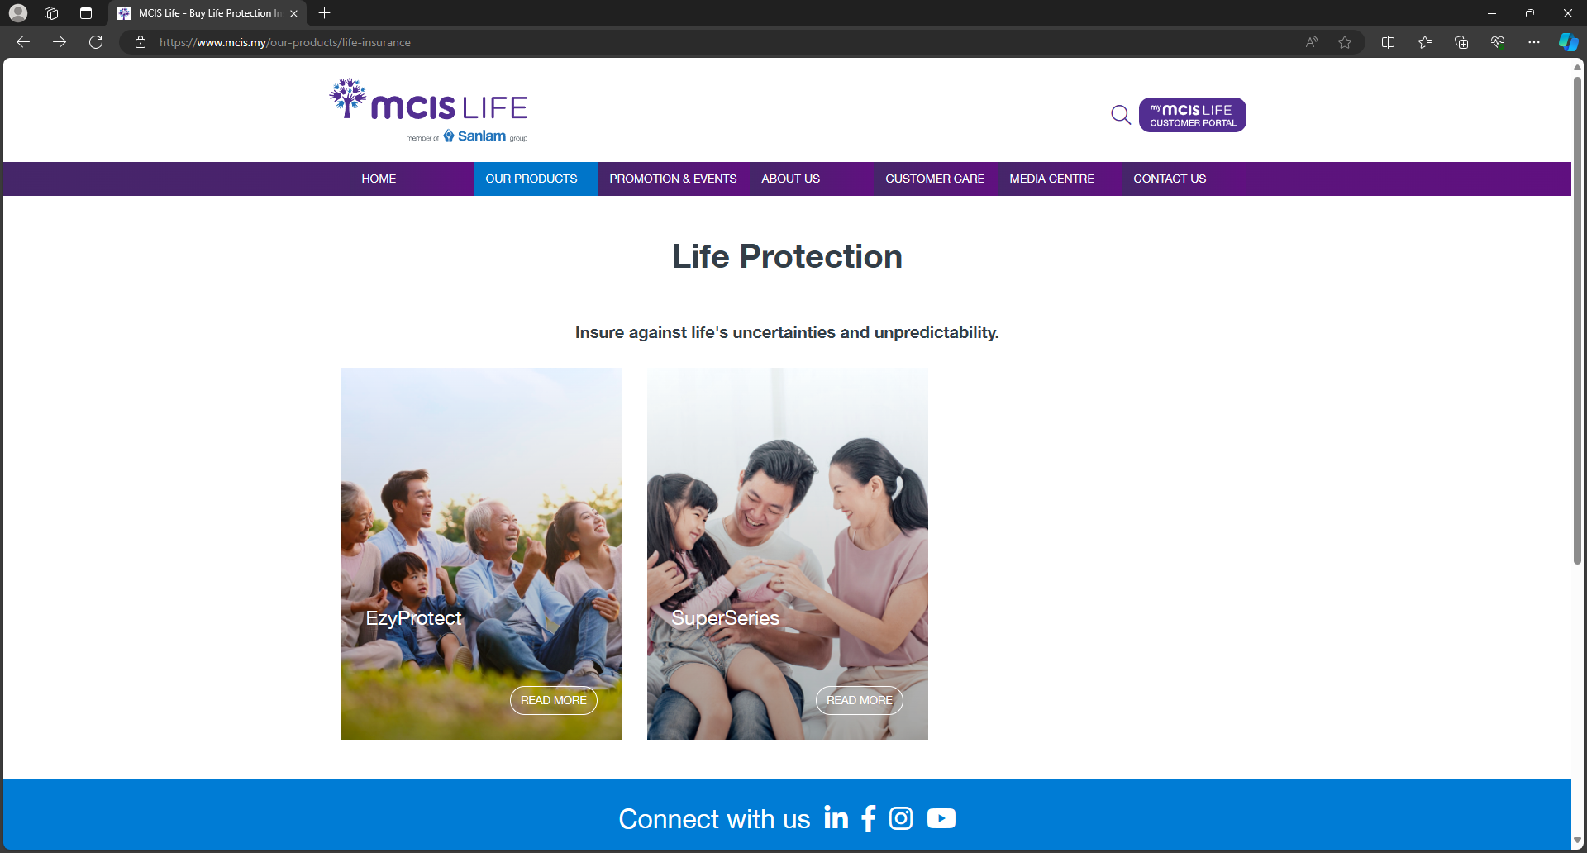
MCIS Life
2. Visit each product type link, scrape links to product pages and names
product name

Slide 15
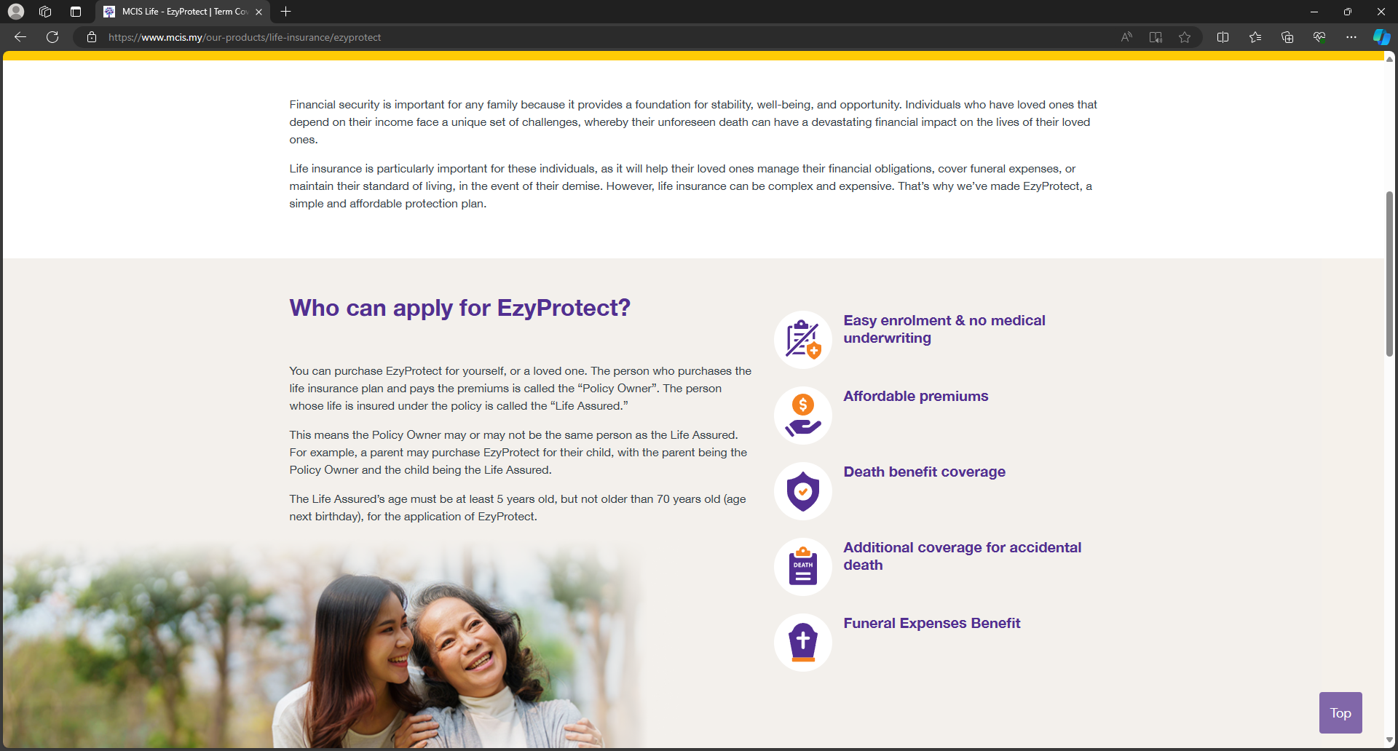
MCIS Life
3. Visit each product site, scrape product description
description

Slide 16
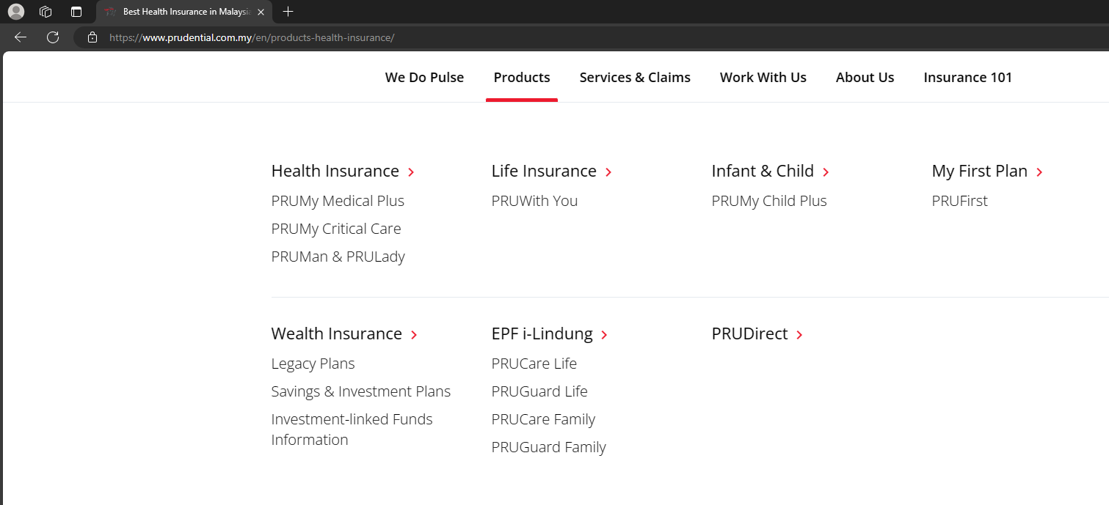
Prudential
1. Start at products menu dropdown to product types, product names and product site links
product type
product name

Slide 17
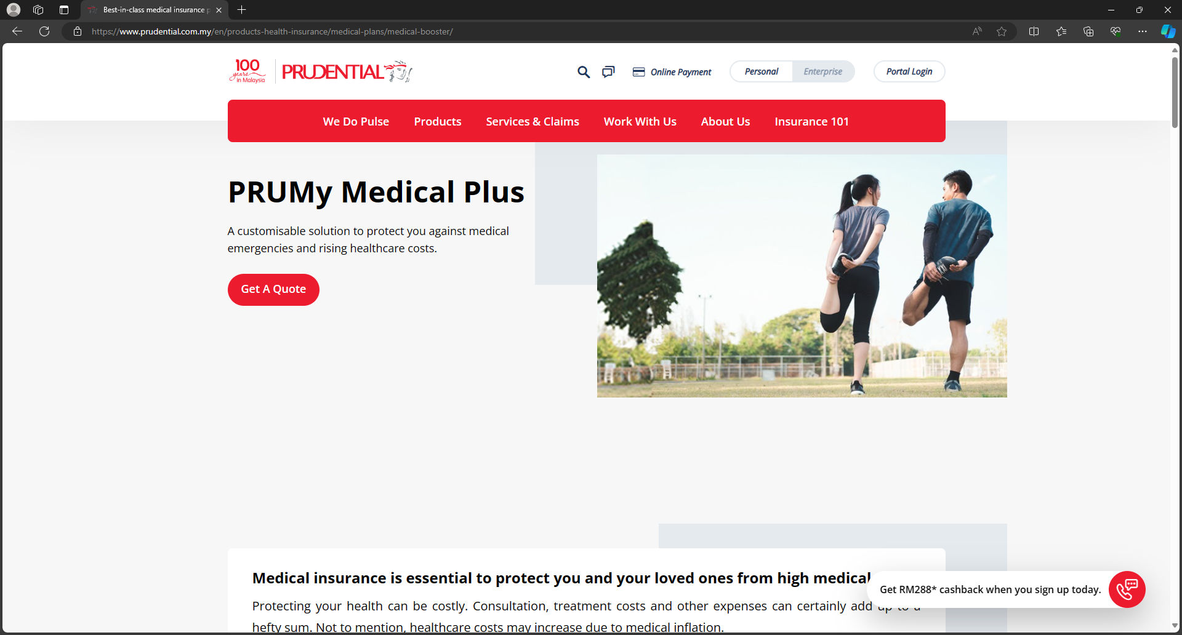
Prudential
2. Visit each product’s site to scrape descriptions
description

Slide 18
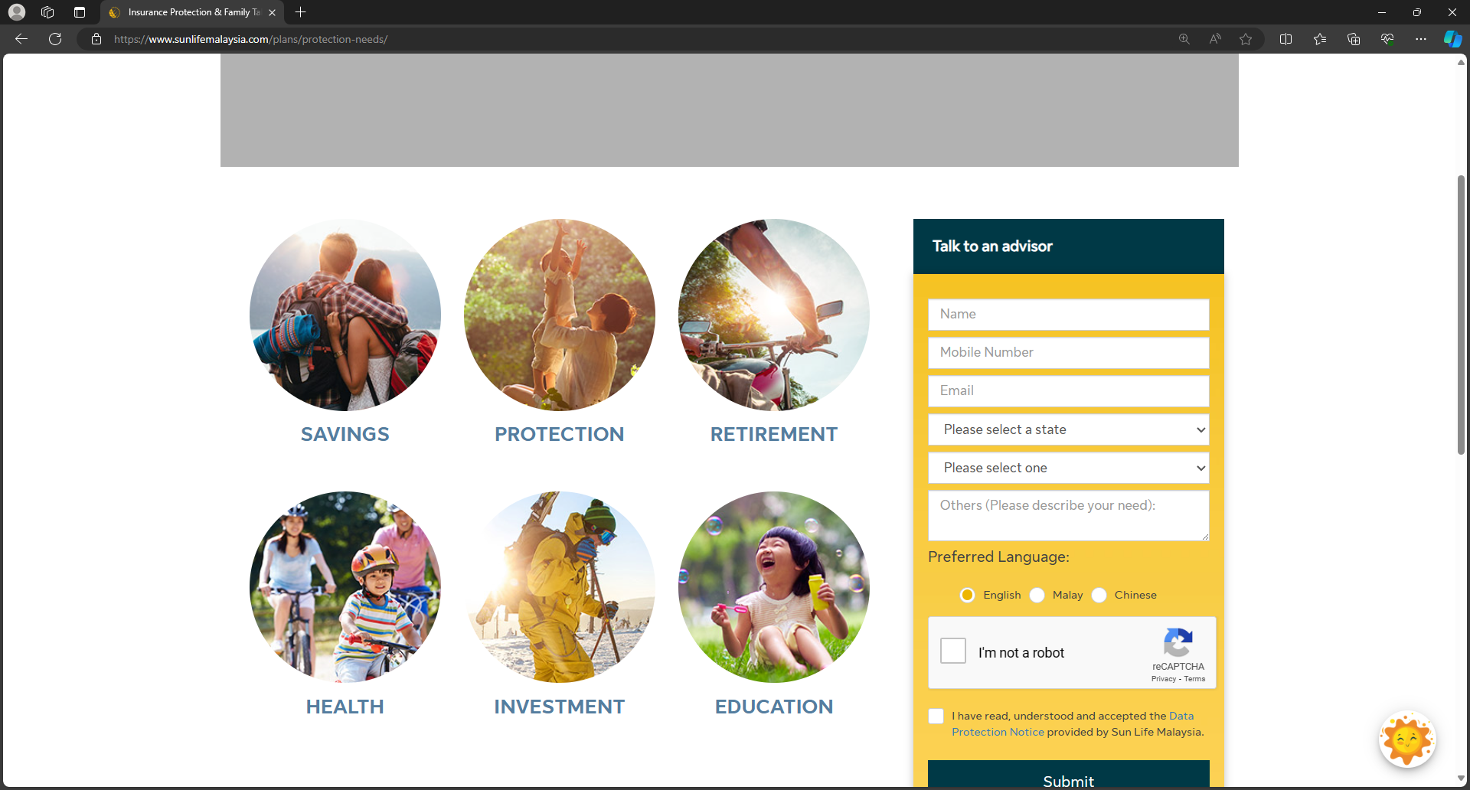
Sun Life
1. Start at ‘protection needs’ site, scrape links and product types
product type

Slide 19
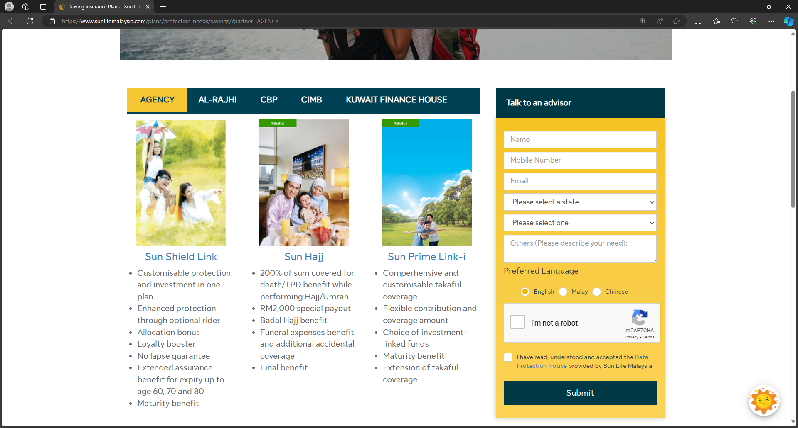
Sun Life
2. Visit each link, scrape links in blue
3. Visit each blue link, scrape name and description
product name
description

Slide 20
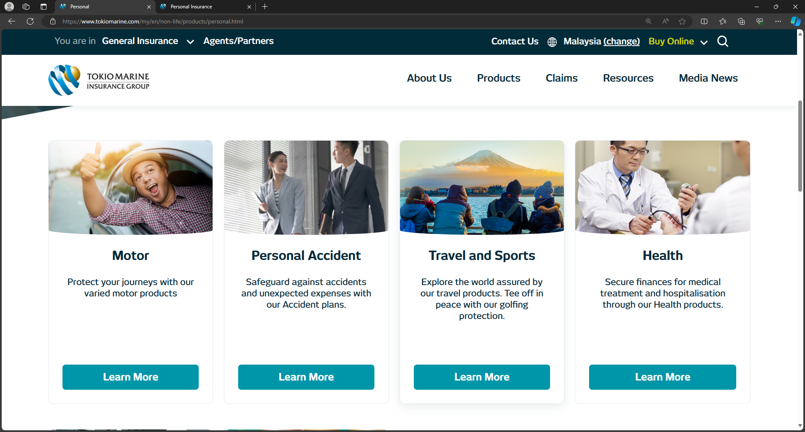
Tokio Marine
Start at ‘Personal Products’ sites (they have 1 for GI; 1 for life), scrape product types and corresponding links
product type

Slide 21
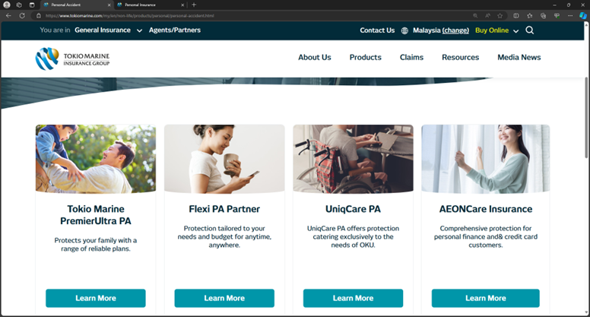
Tokio Marine
2. Visit each link, scrape name & description
product name
description

Slide 22
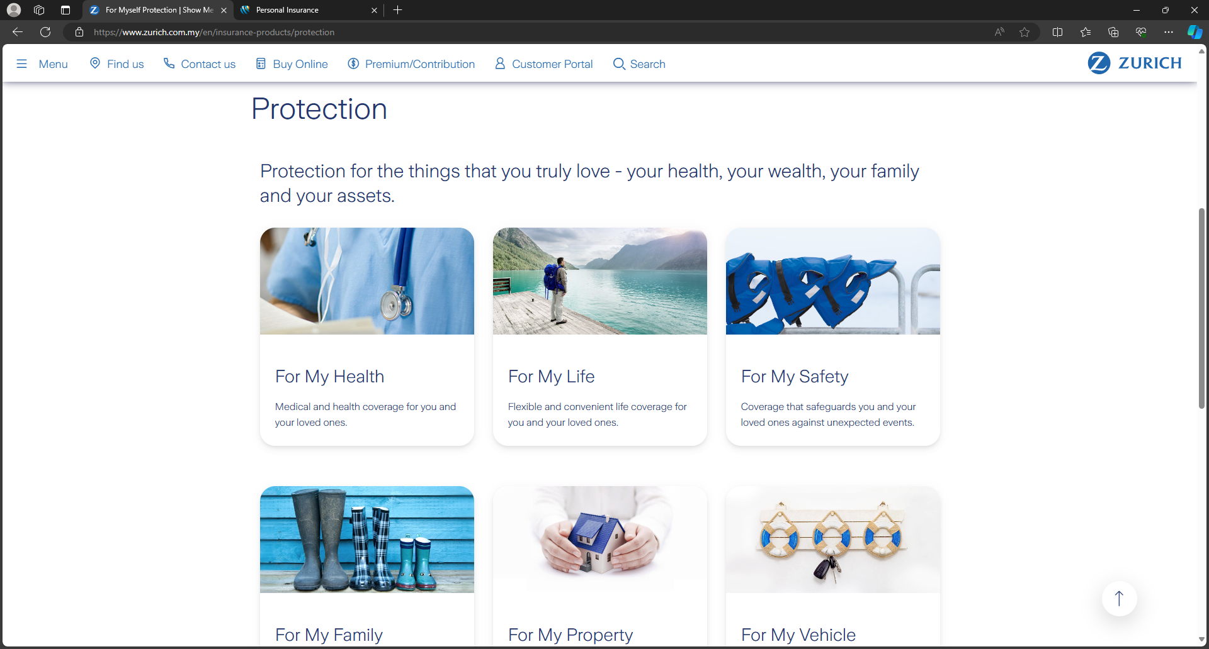
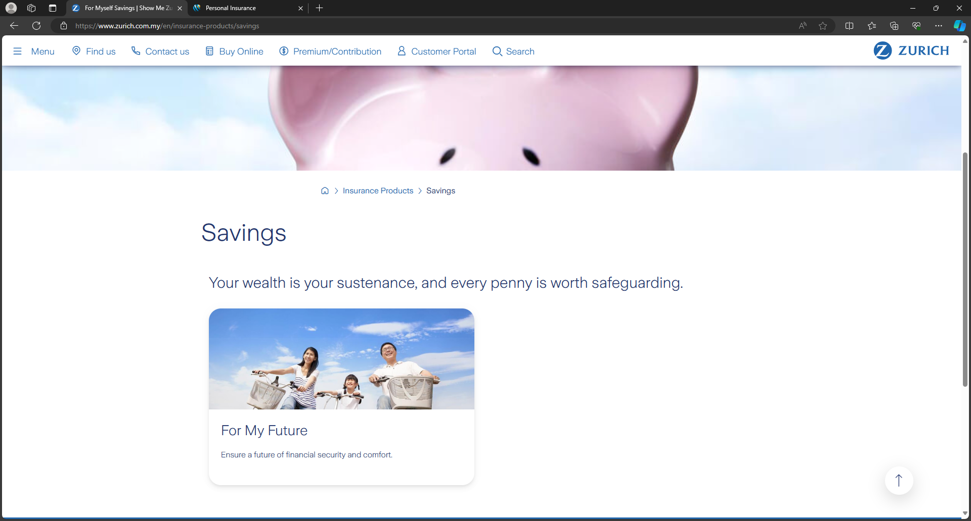
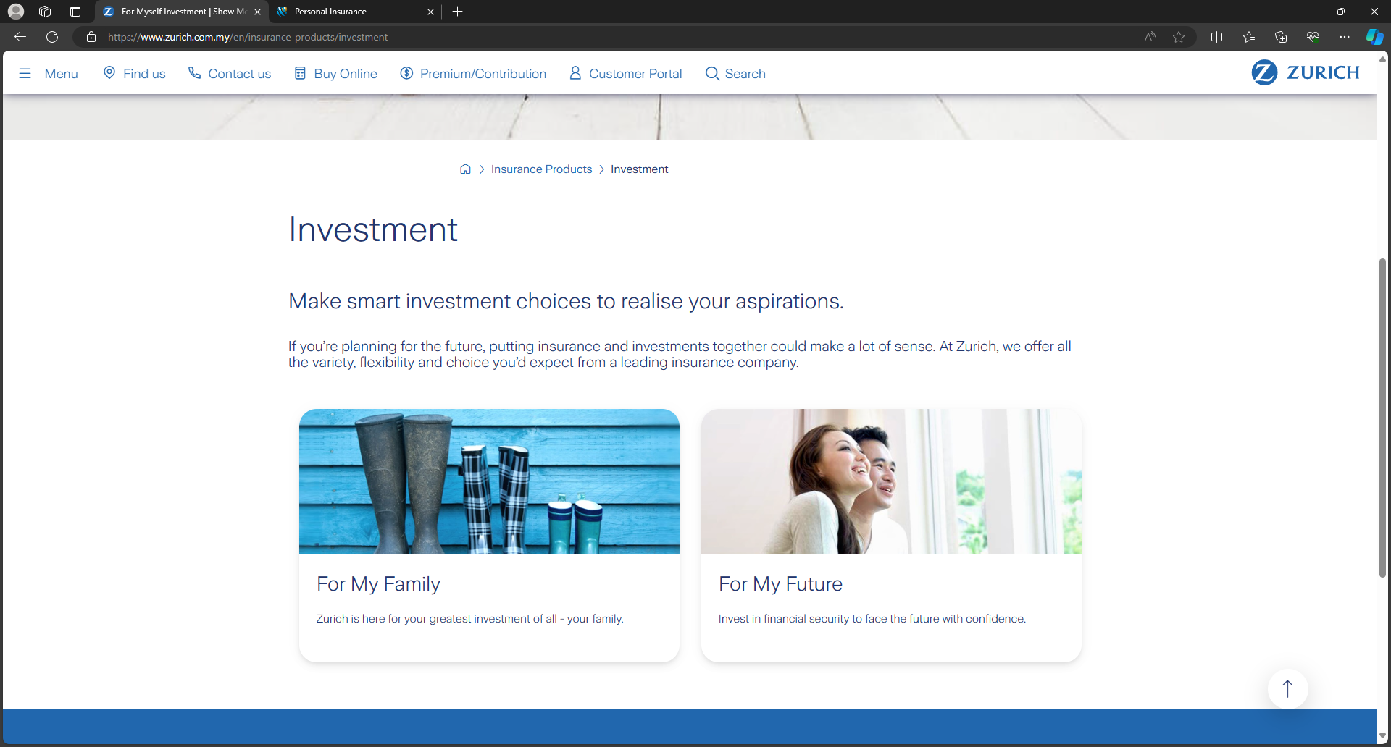
Zurich
1. Start from these 3 sites: Protection, Savings, Investment. Scrape sub-categories’ links

Slide 23
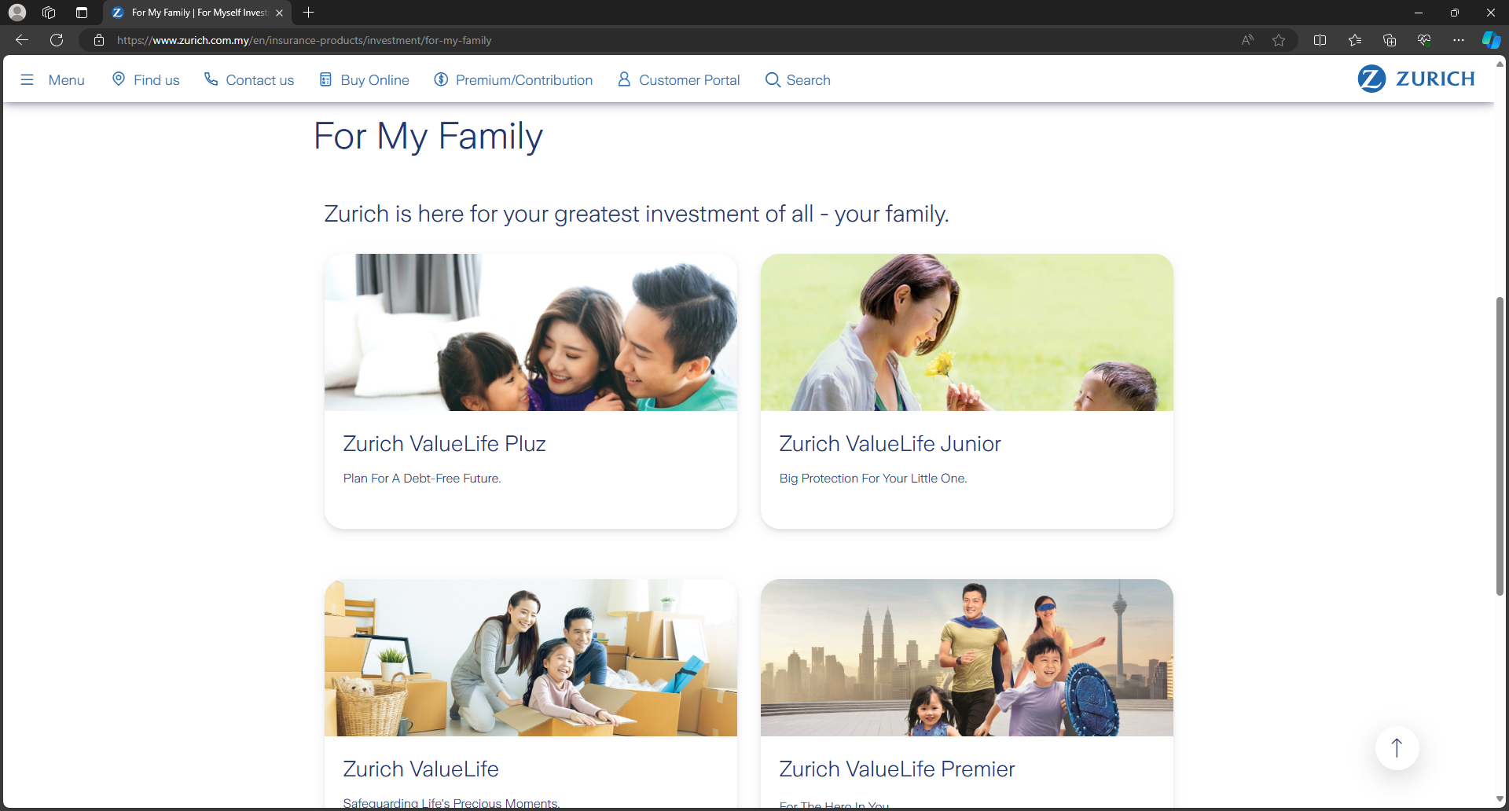
Zurich
2. Visit sub-categories’ links and scrape product names, description. Product type derived from url.
product type
product name
description

